Slide 1
Welcome to PGCE FE Mentor Training
Wednesday 2nd November 2022

Slide 2


Slide 3
Today’s objectives
To:
Launch this year’s PGCE mentoring group
Review and discuss the overall teaching practice assessment process for the PGCE FE
Review the documentation for the process
Explore the ONSIDE mentoring approach
Signpost additional resources.

Slide 4
Feedback from Mentors’ Survey 2021-22
Impact
“It enabled me to continue to develop my own practice as well as completing research to support my trainee”
“Gave me the chance to help someone with their career progression.”

Slide 5
Other questions for today?

Slide 6
Course Approach: Integrated Delivery
This year’s key priority is to focus on the integrated delivery of the course.
Practice Themes which are mapped across the course (curriculum and practice)
Communication across the partnership, via
  Mentor Training
  University Support
  Mentor Connect Newsletters
  Teams Drop-ins
  Joint Learning Observations
  PAG (partnership Advisory Group)
Quality Assurance to promote consistency (teaching, observation, assessment)

Slide 7
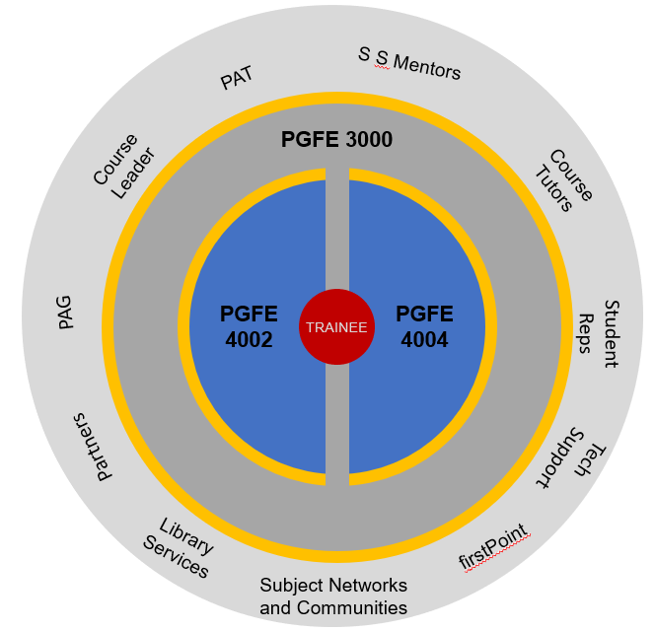
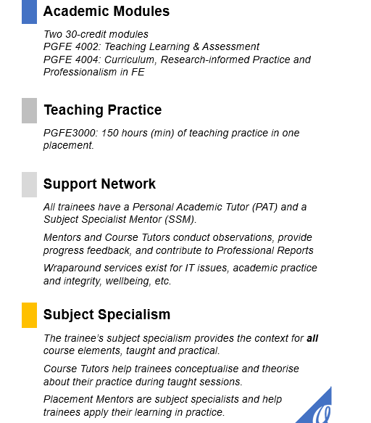
PGCE FE course components

Slide 8
Sep
Oct
Nov
Dec
Jan
Feb
Mar
Apr
May
Jun
Jul
8 observations
Nov -May
Subject days
PGFE-
3000
PGFE4002
2 days September
Assignment A
October
PR 1
Formative – Task 1
Preview Assignment B
November
Module input
Formative – Task 2
January
PR 2
Submission
Part A
(literature review)
PGFE4004
Marking window
Assignment B
April
Formative – Task 1
May
PR 3
Submission – Task 1
Part B
(presentation)
1
Marking window
FE module assessment
overview

Slide 9
Teaching Practice Assessment requirements
8 observations (4 subject mentor/ 4 University) – 1st observation is a joint learning observation (JLO) for new mentors and mentors who have not completed a JLO before
Verified evidence of 150 hours teaching practice
3 Professional Reports – submission dates October, February and May
A final viva voce of progress against the Professional Standards (mentors are invited to participate)

Slide 10
Trainee Teaching Practice entitlement is:
Access to 150 hours (minimum) of teaching in a full role - whole group, small group and 1 to 1 –current recommendation is variety but mainly whole group
Regular mentor meeting – protected time –ideally fortnightly
Receive regular, informal observation feedback, unseen observations (drop-ins, short written comments, images ( learner work, learning environment set up, trainee in action – no learners can be photographed)
1 Tutor Connect visit - QA
Have 4 mentor observations with written feedback (from December to May)
Receive 2 written Professional Reports from Mentors – entered directly to PebblePad as part of tripartite assessment process
Access to college policies and systems as required
Mentor duties in bold

Slide 11
Teaching timetable
How trainees meet the teaching practice hours requirement varies depending on confidence, subject and other factors.
As a general rule, trainees should build up from the end of induction to December to at least 6 hours teaching per week. From January, trainees should be able to build to a maximum of 10 -12 hours per week. We are aware that teaching duties change after Easter and recommend that trainees are approaching the target then. 150 hours teaching is seen as a minimum target.

Slide 12
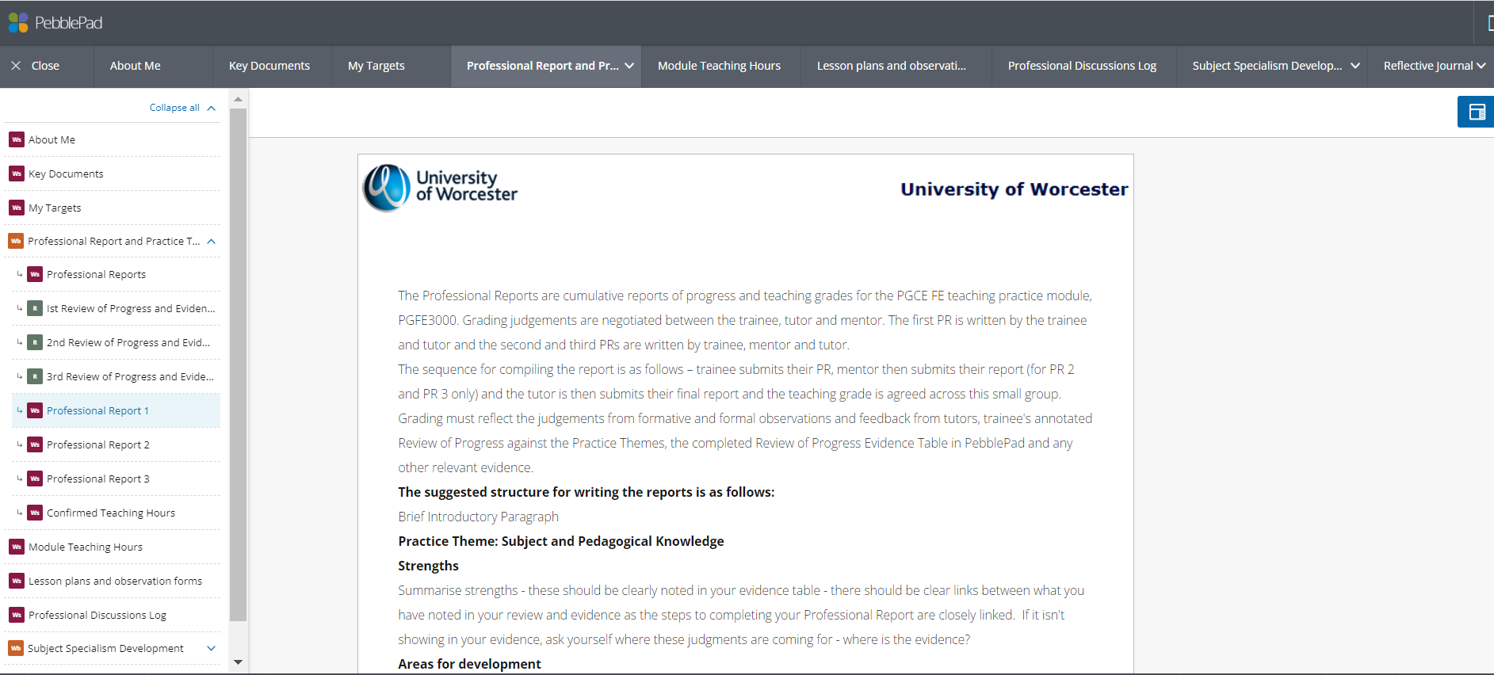
Teaching Practice e-portfolio PebblePad
Trainees complete a teaching practice portfolio in PebblePad which they share with their mentor.
Trainees manage the portfolio and mentors and tutors have access. Your trainee will walk you through PebblePad.

Slide 13
Capturing the mentoring experience and learning
PebblePad is the trainee’s professional and personal development portfolio. Mentors and tutor share access but it is the trainees responsibility to generate and make sense of evidence.
Examples of mentee/mentor generated evidence:
Regular mentor meetings – recorded by trainee in the Professional Discussions Log;
Mentoring agenda (mentee guide) encourage trainees to talk through topics and record discussions/actions
Verbal feedback/ informal conversations which mentee captures in PebblePad.

Slide 14
Key documents
Review of Progress against Practice Themes Log Book – provided in print by your Mentee in the next week or so. Use this throughout your mentoring role.
Lesson Plan and Observation Form – sent to observer 2 days before observation by trainee. Observer to complete professional discussion and write observation within 10 working days.
Professional Reports (PR) 1,2,3 Formative assessment. Contributions from Trainees (1st) Mentors (2nd) and Tutors
(3rd). This reflects the tripartite model and the grade claimed by the trainee in their initial report should be agreed.
PR1 Trainee/tutor (Dec); PR2 Trainee/mentor/tutor (Feb); PR3 Trainee/mentor/tutor (May)

Slide 15

Practice Themes
CLE
Classroom &
Learner Engagement
PLA
Planning for Learning & Assessment
SPK
Subject & Pedagogical Knowledge
PD
Professional Development
EP
Evaluating Practice
ETF Professional Standards

Slide 16
Practice Themes
EP Evaluating Practice | SPK Subject & Pedagogical Knowledge | CLE Classroom & Learner Engagement | PLA Planning for Learning & Assessment | PD Professional Development
Critical Reflection | Subject Knowledge | High Expectations | Developing Learner Autonomy | Sustainability
Continuous Learning | Evidence-informed Practice | Relationships | Equality, Diversity, Inclusion | Communities & Networking
 | SEND | Wellbeing | Safe & Relevant | Ethical & Legal
 | Assessment & Feedback | Motivation | Digital Skills
 |  | Enrichment & Progression | Maths, English & Employability
 |  |  | Advice & Guidance

Slide 17
Observation and other feedback
Formal – upload to PebblePad by trainee
Lesson plan and observation form
Sent by trainee 2 days in advance of observation
Returned to trainee within a week with developmental targets
Informal – encourage trainee to record this in reflective journal on PebblePad
Conversations in the corridor
Drop-ins – verbal feedback or notes
Review of plans
Subject advice discussions in the office
Unseen observations

Slide 18
ONSIDE Mentoring

Slide 19
What is mentoring?
There are many definitions of and approaches to mentoring.
The ETF’s Mentoring Framework and accompanying guides are focused on a process that involves
“teachers and trainers supporting colleagues on a one to one basis over a sustained period of time to bring about professional learning and development.”
Mentoring Framework (ETF, 2021)

Slide 20
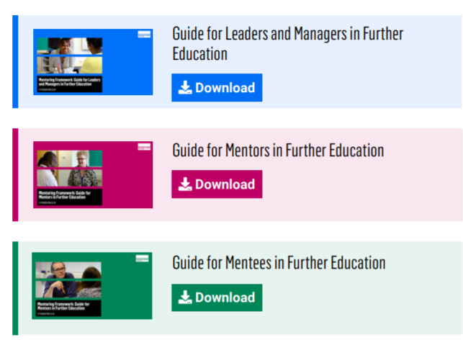
The ETF Mentoring Framework

Slide 21
The ONSIDE mentoring approach
O | Offline. Separated from line management and supervision, and non-hierarchical
N | Non-judgmental and non evaluative
S | Supportive of mentee’s psycho-social needs and wellbeing
I | Individualised. Tailored to specific and changing needs (emotional and developmental) of the mentee
D | Developmental and growth-oriented. Seeking to promote the mentee’s learning and to provide them with appropriate degrees of challenge
E | Empowering. Progressively non-directive to support mentees to become more autonomous and agentic

Slide 22

Managing Expectation
Your mentoring role is valuable to the development of your mentee.
It is important that you manage your time effectively to protect your own wellbeing as well as providing support for your mentee.
It is a powerful and rewarding role and your commitment to it is to be applauded but don’t forget to take care of your own continuing professional development!

Slide 23
Case Study - Mustafa
Mustafa is a mature trainee ICT teacher employed at a college. His subject knowledge is extensive and he has much to offer his students. During a mentor meeting he declares that he is struggling to manage the behaviour of his level 1 students which makes him both anxious and annoyed.
What advice and support would you offer to Mustafa to help him to overcome these challenges?

Slide 24
Case Study - Trevor
Trevor is an inspirational teacher who motivates and engages his learners really well. He truly does bring his Maths lessons alive! Learners are on task and making good progress in all of his classes. Trevor’s DET tutors and observers report that the written documentation that Trevor submits to evidence his teaching is sketchy and sometimes incomplete.
How would you help Trevor to develop this area of teaching practice?

Slide 25
Next steps …
Get to know your trainee and establish your mentoring routine
Arrange the JLO with mentee and course tutors
Access the resources available
Always ask!
Attend the Dec/Feb PGCE FE Mentor Connect Drop-in meetings – on Teams

Slide 26
Support and information for mentors
Training
Joint Learning Observation(JLO) with University tutor early in course 1st learning observation for mentors is a JLO with UW tutor which is written up by UW tutor and shared.
Mentor training sessions 2nd Nov. ’22 and 3rd March ’23. – informal Teams meetings at the end of every month (term time)
Resources
Partnership resources are available on the PGCE FE Partnership webpage – link to be forwarded
PGCE FE Partnership Handbook covers: key dates; roles and responsibilities; entitlements ;procedures and documentation descriptions;
document templates and exemplars
Communications
Termly newsletter – PGCE FE Mentor Connect Newsletter -focus on integrating course components
PGCE FE Mentor Community Connect- informal Teams meeting (Dec/Feb)

Slide 27

Finally…

