Slide 1
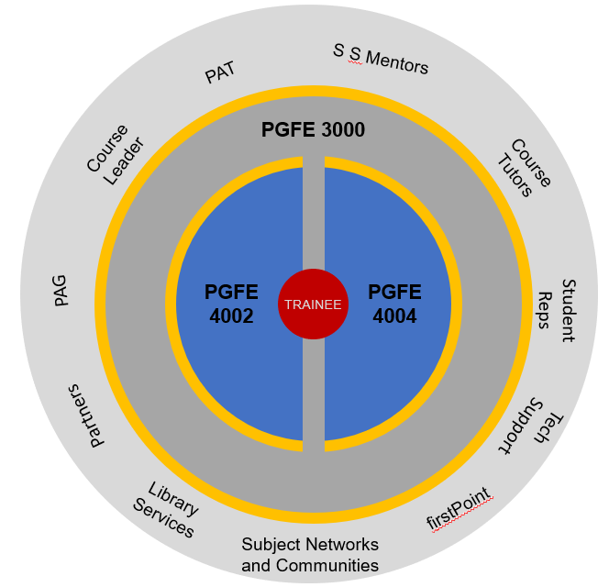

PGCEPGCE FE Course Components

